Slide 1
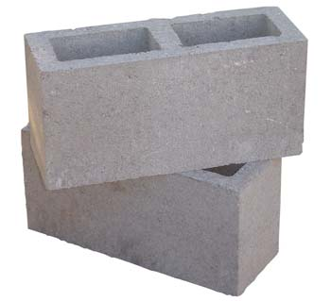
Tracking the building blocks of
Compound Words
Maybe in order to understand mankind we have to look at that word itself. MANKIND. Basically, it's made up of two separate words "mank" and "ind." What do these words mean? It's a mystery and that's why so is mankind.
Jack Handey
Teon Brooks
Daniela Cid de Garcia

Slide 2
How do we recognize words?
What is the role of morphological structure in mapping perceptual information?
In order to recognize a word, do we necessarily need to look into its constituents?
RULE-BASED processing
COMPLETE storage
IS IT MORE EFFICIENT TO...
... store only what cannot be derived by rules?
 and rely on the operation of these derivational rules
... store every piece of information
 and depend on the availability of memory space and on efficient access procedures.

Slide 3
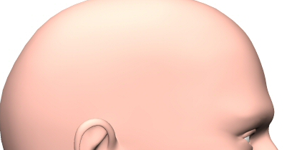
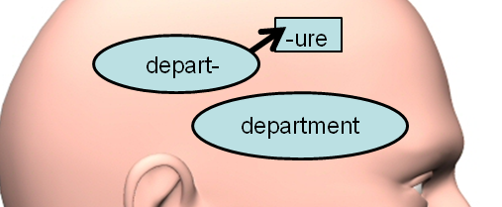
The literature tells us…
depart
deposit
FULL-LISTING
models
department
leave
Butterworth, 1993; Seidenberg & McClelland, 1989
FULL-DECOMPOSITION
models
/\
/\
/\
Taft & Foster, 1975; Stockall & Marantz, 2006
DUAL
models
Caramazza, Laudanna & Romani, 1988 ;Marslen Wilson et al., 1994;
Pinker, 1991

Slide 4


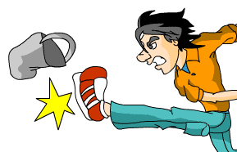

Semantic Transparency
A multimorphemic word is semantically transparent if the meaning of the whole word is predictable from the meaning of its constituents.
Previous works show overwhelming evidence that semantic transparency plays a role in the representation/activation of multimorphemic words.
To what extent morphological process is constrained by semantic transparency? (i.e. to what extent is the meaning of a whole word derived by the meaning of its constituent morphemes?)
combinatorial vs. idiosyncratic
How is arbitrary meaning instantiated in a sub-lexical domain?

Slide 5
Morphological Computations in Linguistic Theory
Distributed Morphology. Syntax all the way down
Halle & Marantz (1993)
√teach + n
Encyclopedia
√teach+Ø = teach
teach = to impart knowledge or skill to
Root+v
Root
√
√teach+ er = teacher
LEXICAL ACCESS

Slide 6
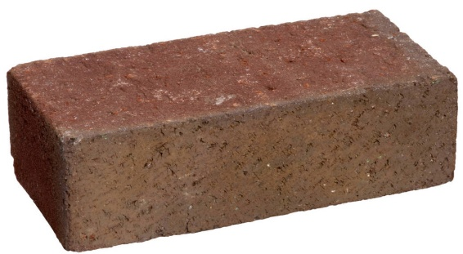
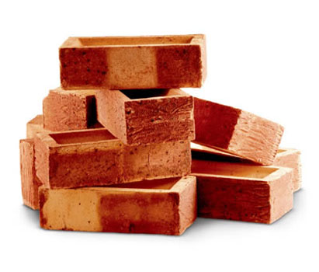
Morphological Computations in Cognitive Neuroscience
1)
hogwash
decompose
hog wash act. atoms
compose
hogwash
2)
hogwash
hogwash
Also:
Different experimental paradigms target different levels of processing!
washable
washing
washed
brainwash
hogwash
carwash
Washington?
WASH

Slide 7
Derivational morphology
teach – teacher - root sharing
apart – apartment - historical root sharing
corn – corner - pseudomorpheme
broth – brothel - orthography only
What is the basic level of representation in each of these cases?
-er
-er
teach
corn
-ing
Psycholinguistic studies have shown that there seems to be a priority on identifying potential morpheme-level constituents during early stages of word processing, regardless of factors such as semantic transparency. (Rastle at al. 2004; Longtin et al. 2003; …)

Slide 8
On the time course of word recognition
Many factors are involved in the task of recognizing a word – linguistic and non linguistic factors; pre-lexical and post-lexical factors.
syntax?
something else?
Psycholinguistic resuts (priming):
masked
overt
Early Visual morpho-orthographic facilitation
Facilitation regulated by semantic pairing – lexical access
Facilitation due to later semantic and phonological/ororthographic factors;
context; discourse
Orthography with morphological flavour
teach-teacher
tea-teacup
teach-teacher
corn-corner
apart-apartment
tea-teacup
hogwash-hog
violin-cello

Slide 9
Zooming in the compounds
Methodological benefits
“Compounding as a word formation type is attractive in part because we (arguably) understand access to open class lexical items much better than we do affix representations.”
“Possible to utilize relatively well-understood psycholinguistic & neurolinguistic measurements designed to detect effects of lexical properties for openclass items.” (Fiorentino, 2010)
More straightforward to detect the constituent morphemes in compounds than in affixed words.

Slide 10
Compounds
sailboat - Transparent
strawberry - Opaque/Transparent
jailbird - Transparent/Opaque
hogwash - Opaque
penguin - Orthographic
What is the basic level of representation in each of these cases?
boat
sail
wash
hog

Slide 11
Previous studies
Marslen-Wilson et al. 2004; Sandra 1990; Zwitzerlood 1994; Opaque compounds (hogwash) resistant to activation through prelexical decompsition. – overt priming with semantically related constituents; eye tracker/intra-sentencial context.
Libben et al 2003; Fiorentino & Poeppel 2007; Fiorentino & Fund-Rezniceck 2009; Brooks (in prep): Prelexical decomposition across the board (sailboat = hogwash) – constituent priming; masked priming; MEG.

Slide 12
Our Experiment
Objective:
-- Probe different levels of transparency to detect different levels of combinatorial effects related to decomposition/ activation/composition in compound words.
Methodology
MEG
Experimental Designs
Priming; n-back
Combinatorial effects related to word decomposition
Combinatorial effects related to word composition – N condition

Slide 13
Our Conditions
Transparency
Transparent (teacup)
Fully Opaque (hogwash)
First Opaque (strawberry)
Second Opaque (jailbird)
---
Novel (winecup)
Orthographic (penguin)
Simple (8-letter word with no embedded words)
Repetition
First vs. Second
Directionality
CompPrime vs. CompTarget

Slide 14
Design
T - 1s | T - 2nd | O - 1st | O - 2nd | TO - 1st | TO-2nd | OT - 1st | OT - 2nd
teacup - tea | teacup - cup | hogwash - hog | hogwash - wash | jailbird - jail | jailbird - bird | strawberry - straw | strawberry - berry
leapfrog - tea | leapfrog -cup | seafood - hog | seafood - wash | milkshake - jail | milkshake - bird | handset - straw | handset - berry
N - 1st | N - 2nd | Orth 1st | Orth 2nd | Simple
winecup - wine | winecup - cup | penguin - pen | template - plate | croissant - croissant
armpit - wine | armpit - cup | oatmeal - pen | oatmeal - plate | longhand - croissant

Slide 15
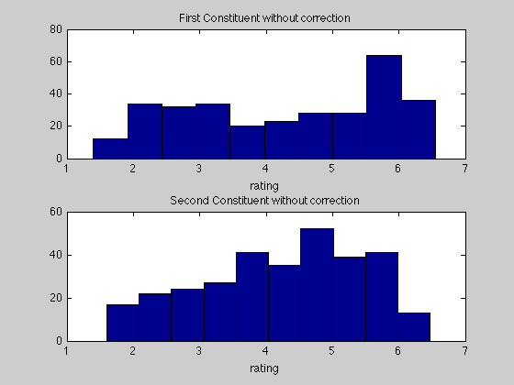
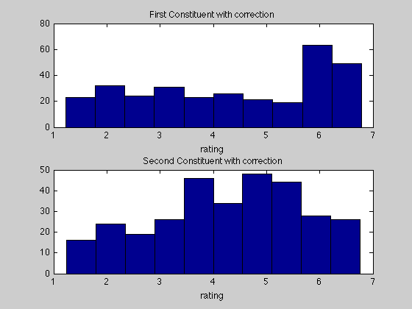
Norming Data Results

Slide 16
Predictions
We’re not there yet……

Slide 17
Issues to consider…
Probing effects of complexity with /without priming – directionality.
Predicate modifiication vs. Compound word formation: To what extent are the sublexical combinatorial processes involved in forming the compound sailboat related to the supralexical combinatorial processes involved in forming the phrase red boat? vmPFC / leftATL
What is it that makes semantically opaque words different from monomorphemic words? Linguistic theory ~ Cognitive neuroscience
What aspects would be behind the prelexical decomposition that happens accross the board in early visual word recognition?
  What is the nature of this segmentation? Unexplainable in terms of identity.
  Is this a purely linguistic effect? (Higher level object recognition? – Zweig & Pylkkanen, 2009)

